Slide 1
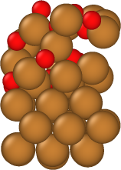
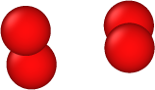
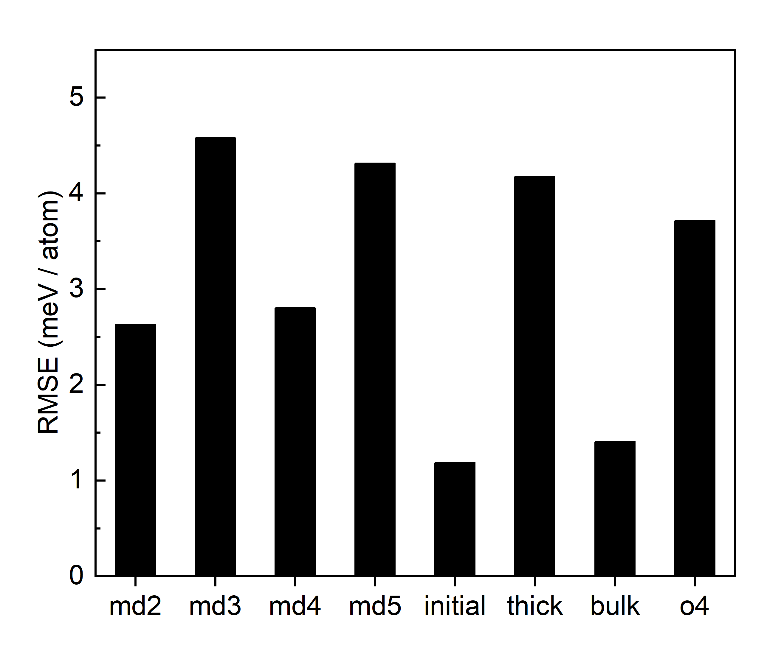
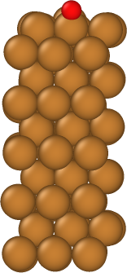
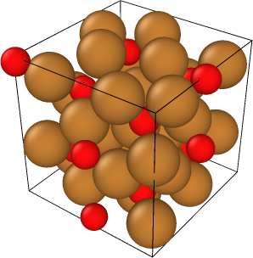
a)
c)
e)
d)
b)

Slide 3
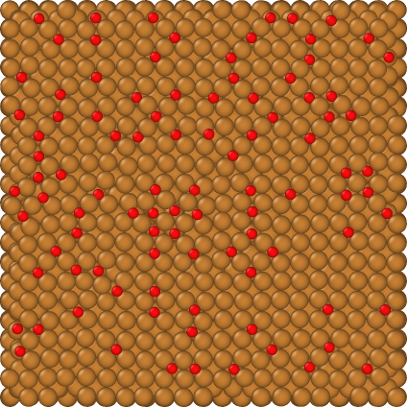
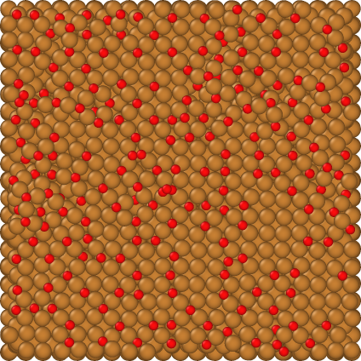
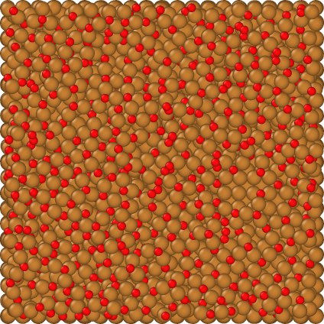
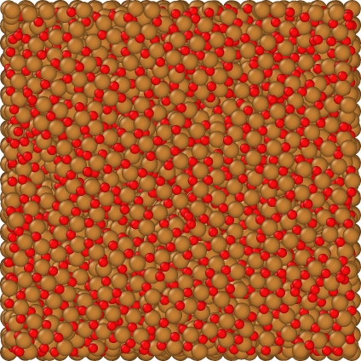
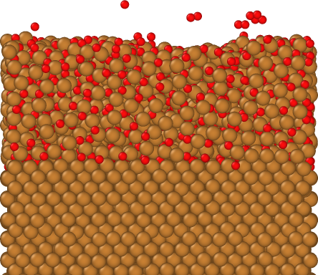

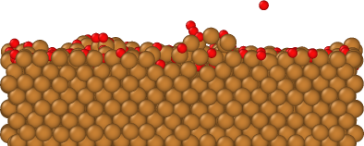
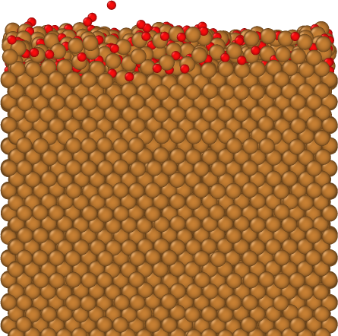
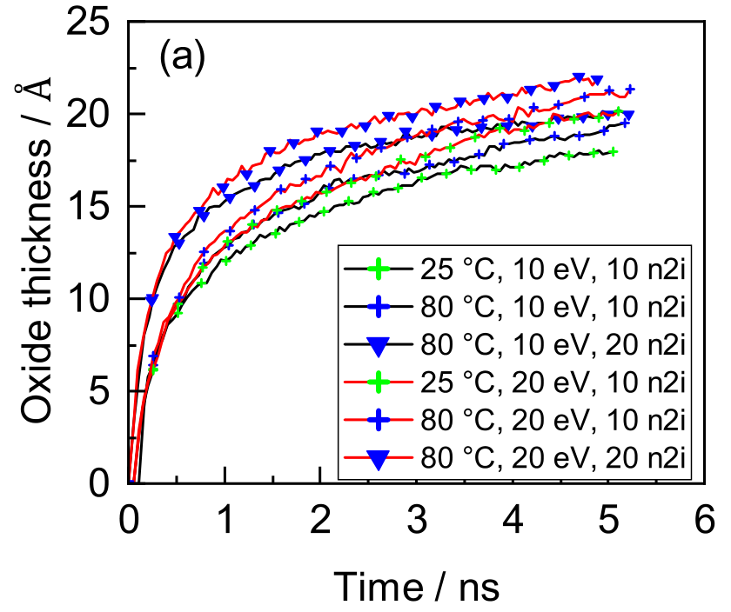

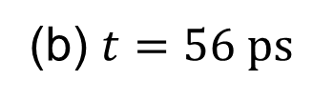

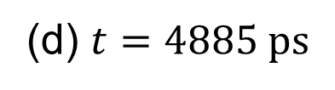
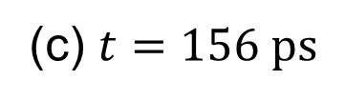
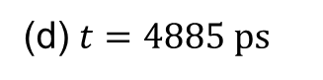


(a) $t=24 ps$
(b) $t=56 ps$
(c) $t=156 ps$
(d) $t=4885 ps$
(a) $t=24 ps$
(b) $t=56 ps$
(c) $t=156 ps$
(d) $t=4885 ps$

Slide 4
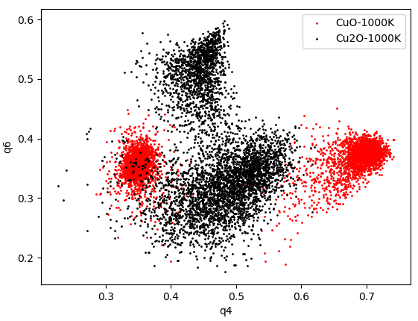
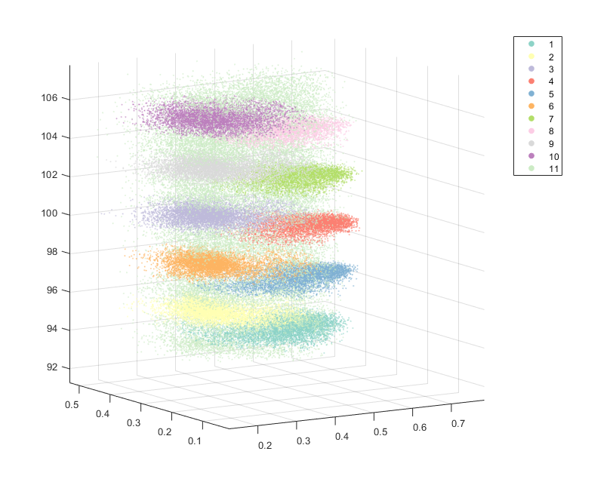

need a better way of illustrating this

Slide 5
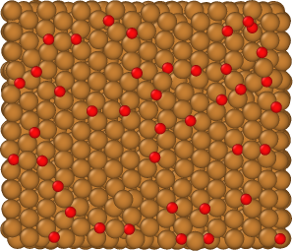
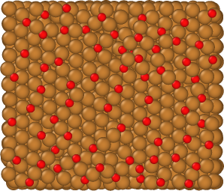
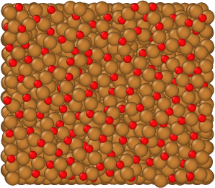
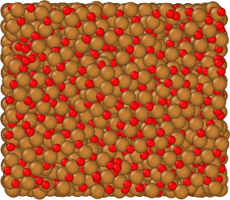
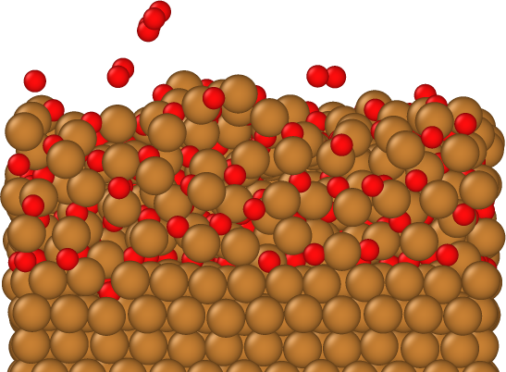
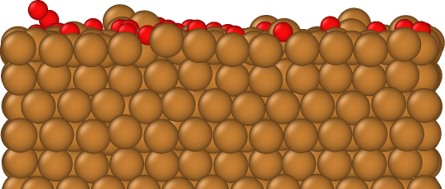
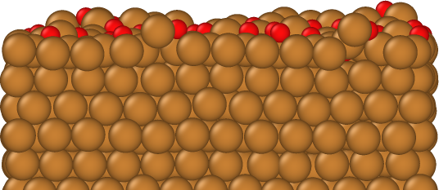
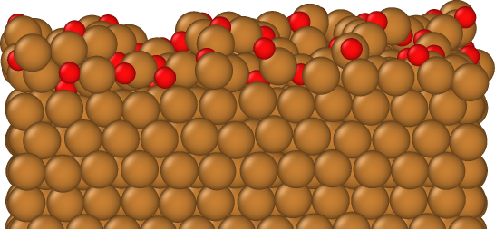
(a)
(b)
(c)
(d)

Slide 6
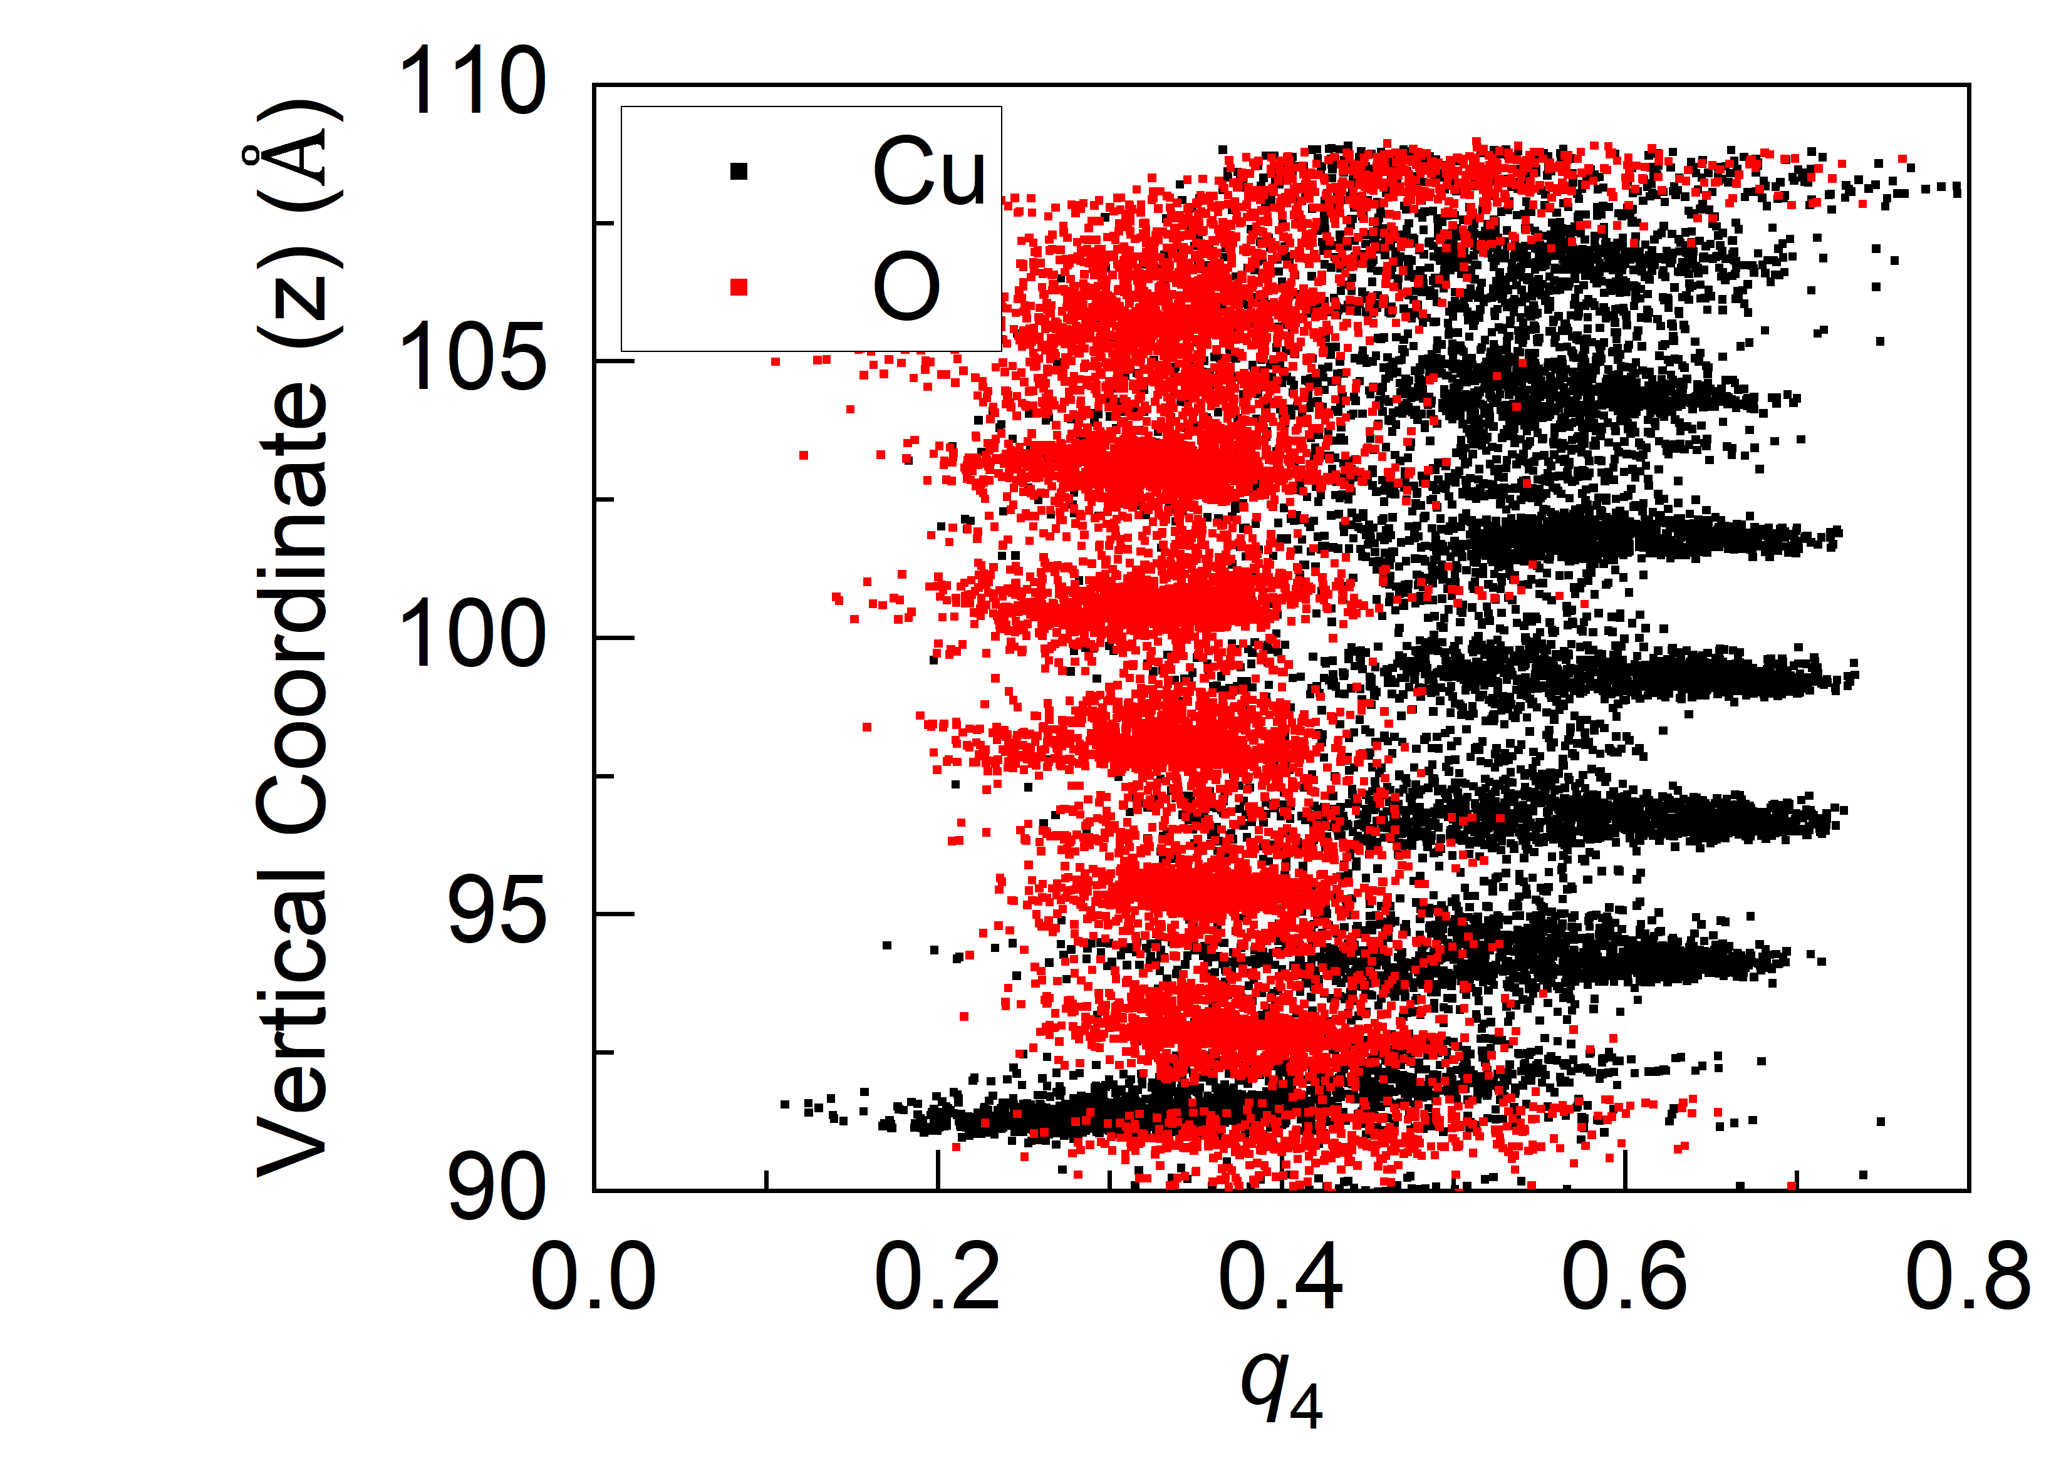
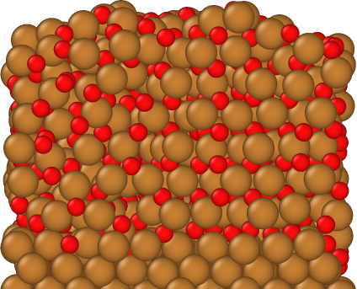
(a)
(b)

Slide 7
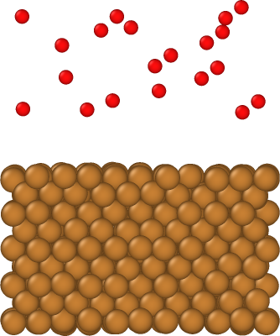
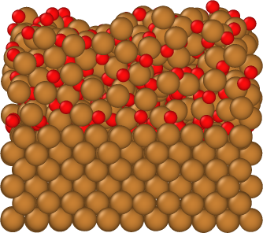
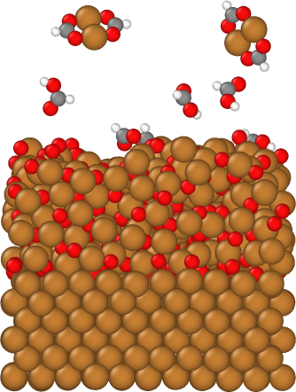
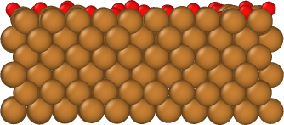

Slide 8
$$\frac{n}{4}\sqrt{\frac{8k_{B}T}{πm}}=P\sqrt{\frac{1}{2πmk_{B}T}}=1.384×{10}^{23} \frac{1}{m^{2}s}{\left(\frac{1m}{{10}^{9}nm}\right)}^{2}×\left(\frac{s}{{10}^{15}fs}\right)=4.378×{10}^{23−18−13}=4.378×{10}^{−10}\frac{1}{{nm}^{2}s}$$
(a)
(b)
$$\frac{n/V}{4}\sqrt{\frac{8k_{B}T}{πm}}=\frac{P/RT}{4}⋅N_{A}⋅\sqrt{\frac{8k_{B}T}{πm}}=\frac{P/k_{B}T}{4}\sqrt{\frac{8k_{B}T}{πm}}$$

